Slide 1
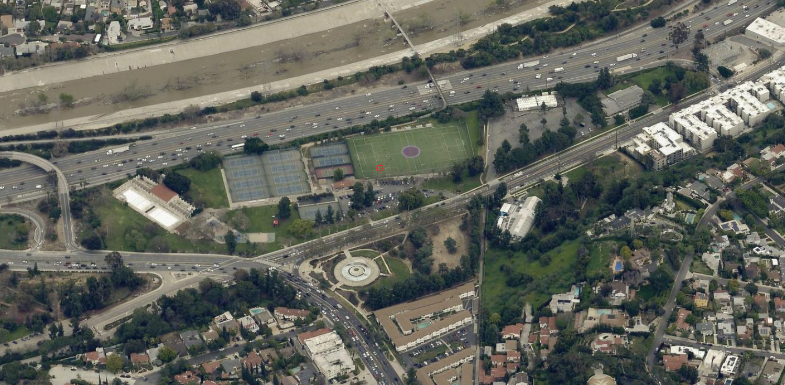
South Griffith Park Improvements
February, 2024 Presentation
Master Plan and Griffith Park Pool Restoration

Slide 2
Presentation Outline
Vision & Purpose
Issue History
South Griffith Park Master Plan Goals and Scope
Location Map
Master Plan Process & Timeline
Griffith Park Pool Restoration
Other Current Park Projects
Big Picture Takeaway
Conclusion
Notes:
JH

Slide 3
A New Unified Vision for South Griffith Park
It’s time to embark on a new vision for this portion of our beloved Griffith Park!
Our office, in partnership with LADOT, is launching a visioning process to make South Griffith Park more vibrant, welcoming, connected and sustainable.
What do we envision? Safer connectivity, thriving arts and cultural placemaking, and a diversity of activities for different generations that will make this destination more useful for people throughout the region and in the neighborhood.
This process will address the need for a new Griffith Park Adult Community Center (GPACC) and new recreational uses for the area, bringing it all together in a coherent, cohesive community-centered way
Notes:
MB

Slide 4
Issue History
The Griffith Park Adult Community Center opened in 2008 after two portable buildings were moved to the parking lot of Friendship Auditorium on Riverside Drive near the entrance to Griffith Park.
In 2019, Councilmember David Ryu’s Office introduced a motion instructing the Department of Recreation and Parks (RAP) to facilitate a discussion regarding the feasibility of redeveloping GPACC. This motion expired without action in 2021.
In 2022 and 2023, the Griffith Park Advisory Board created a South Griffith Park Ad Hoc committee to report on existing conditions and potential uses in the location. The ad hoc released a report in May, 2023.
The CD4 team used the ad hoc committee report, as well as information gathered from meetings with GPACC and other stakeholders and RAP staff, to craft a draft scope for RAP to use to develop a procurement request for a consultant to help complete this planning work.
CM Raman introduced CF 23-1334 to identify front-funding and direct RAP to begin a procurement process for a consultant.
Notes:
MB

Slide 5
South Griffith Park Master Plan Goals and Scope
Guiding Principles
Satisfy public needs including cultural enrichment, education, and supportive services
Remain consistent with 1978 Master Plan and 2014 Griffith Park Vision Plan: South Griffith Park which designated this area an opportunity for active recreation, and other uses
Provide expansive and innovative community engagement strategies
Goals
Assess existing uses and facilities and their needs
Identify the best location for a new structure for GPACC and desired uses for that (or any other) structure
Determine desired uses for other sections of the Project Area
Improve transportation and internal circulation for the Project Area
Assess existing and desired concessions, partnerships, and other agreements in Project Area
Notes:
MB

Slide 6
South Griffith Park Master Plan Goals and Scope
Scope
RAP facilities and land, plus RAP-managed and maintained facilities in Project Area
DWP facilities and land on Riverside Drive
Transportation and circulation needs in Project Area
Roadways, LA RiverWay active transportation path, Sunnynook Bridge, and internal circulation area
Existing and desired concessions, partnerships, and agreements
Notes:
MB

Slide 7
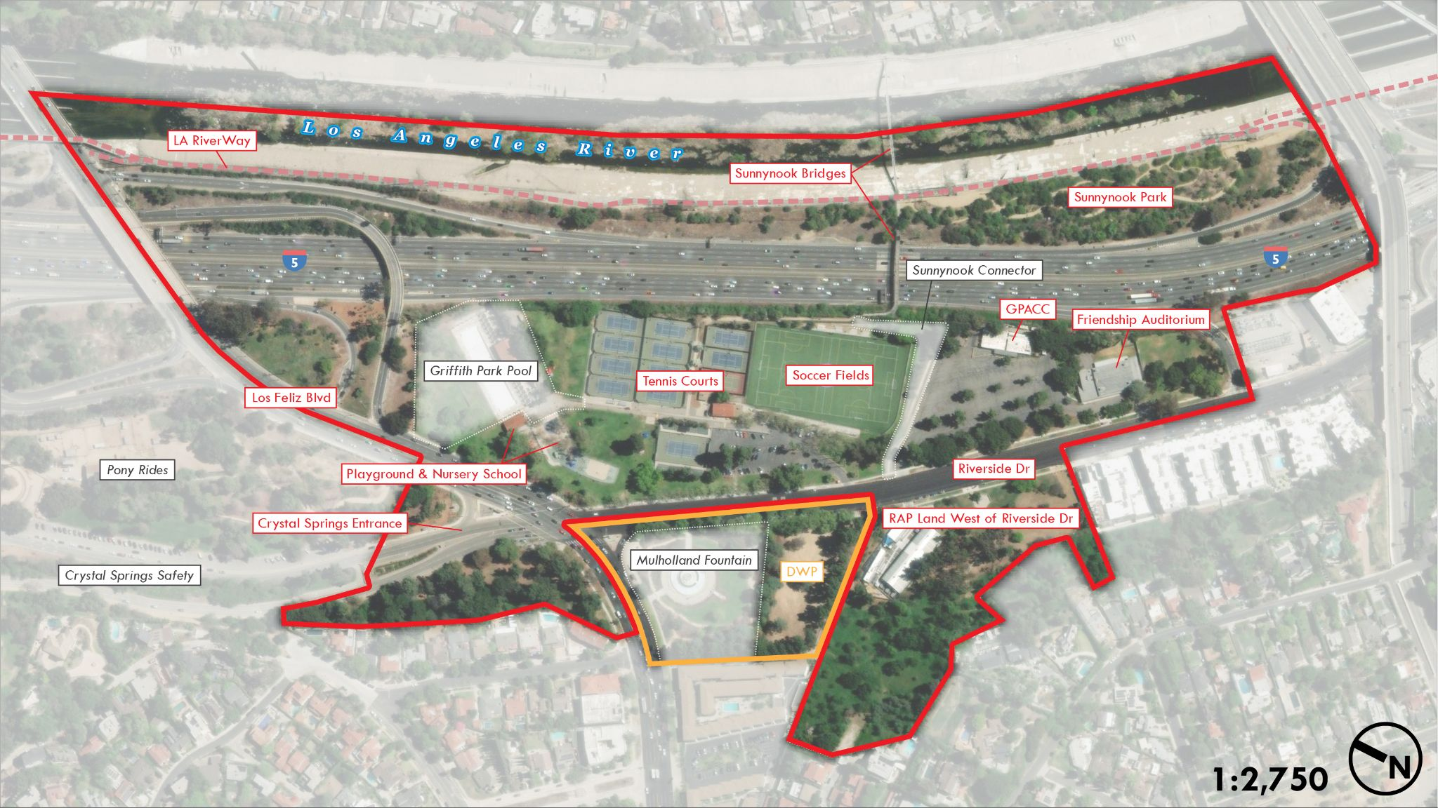
Location Map
Notes:
MB: What is in project first, then what is out of project second

Slide 8
Master Plan Process & Timeline
Report from CF 23-1334 identifying front-funding – March-April, 2024
Create and finalize bid package, send project out to bid – Summer through early Fall, 2024
Community planning and visioning process – 6-8 months
Identify funding and project planning for priorities
Notes:
MB

Slide 9
Griffith Park Pool Restoration
$2M allocated in FY23-24 for hiring a consultant to do design work for Pool restoration
Congressman Adam Schiff’s office has included an additional $2M for the pool in his appropriations request for this year’s budget – budget is yet to pass
RAP has submitted the project for multi-year funding request in City budget
The design for the project was put out to bid and bids have been received
BOE will work to select an awardee and then they can begin design work
Multi-year timeline to complete construction
Notes:
JH

Slide 10
Other Improvements
Zip Line Playground Repairs
New play surface
Repair to zip line
The playground should already be closed for repairs as of the 2/27/24, with work ongoing through early March
New Pathway to Sunnynook Bridge
Would be a new accessible pathway to the Sunnynook Pedestrian bridge over the 5 and LA River
Funded through Measure A
RAP Planning working on conceptual design and title history, among other pre-construction activities
Notes:
JH

Slide 11
Other Current Park Projects
William Mulholland Memorial Fountain Project
Repairs to plumbing, structural, mechanical, and electrical systems of the fountain
Led by DWP
Estimated construction to begin and end in 2027
Pony Rides
Visioning process ongoing to determine potential future uses
Open House at Friendship Auditorium, March 6th, 5:30-8:30
Griffith Park Safety & Active Transportation Improvements Plan – Phase 3
Safety improvements to Crystal Springs Drive including walking & biking lanes
Construction expected to begin in Spring/Summer, 2024
Notes:
JH

Slide 12
Big Picture Takeaway
We need to confirm the best place for a new structure(s) for GPACC, and whether that structure(s) should have other uses as well
We want to identify priority recreational uses so that we plan holistically for the whole section of Griffith Park south of Los Feliz Blvd
We want to identify transportation and circulation opportunities in the plan area
We want to review existing uses and make sure any capital improvement needs are assessed and prioritized
Notes:
MB

Slide 13
Conclusion
Intention to hire a consultant by mid summer, 2024
End deliverable of South Griffith Park Master Plan will be:
Identifying location for a new building and what needs it should serve
Identifying capital infrastructure needs at existing facilities, and how other areas of South Griffith Park should be programmed
Developing cost and implementation estimates for plan projects
The design/construction of the new building and other desired programming will then need to be funded and initiated
Restoration of the Griffith Park Pool is a separate project with its own timeline – we are trying to repair it as soon as possible. We have funding for design and are working on fully funding construction.
Other investments continue to be made in the area
Notes:
MB

Slide 14
Thank you!

